Slide 1
SENIOR CARE AUTHORITY
Mark S Molnar
2.19.2021

Slide 2
WE RELIEVE STRESS
ON YOUR EMPLOYEES BY PROVIDING
GUIDANCE
REAL-DOLLAR SAVINGS
Coming 2022
Information is proprietary and confidential

Slide 3
WHAT WE DO
Senior Care Authority provides high-touch, personalized concierge assistance to local families seeking elder care advice and senior living placement guidance for their loved ones in the greater Cleveland area.
*Franchise model with 70+ locations nationally
Information is proprietary and confidential

Slide 4
TWO PRIMARY SERVICES
ELDERCARE CONSULTING
Clients pay directly for this service
Provide advocacy, referrals, management and guidance through navigating the complex US healthcare systems for aging adults.
PLACEMENT SERVICES
Supplier paid
Work with families to locate the best senior living and care solutions such as assisted living, memory care and independent living.
Information is proprietary and confidential

Slide 5
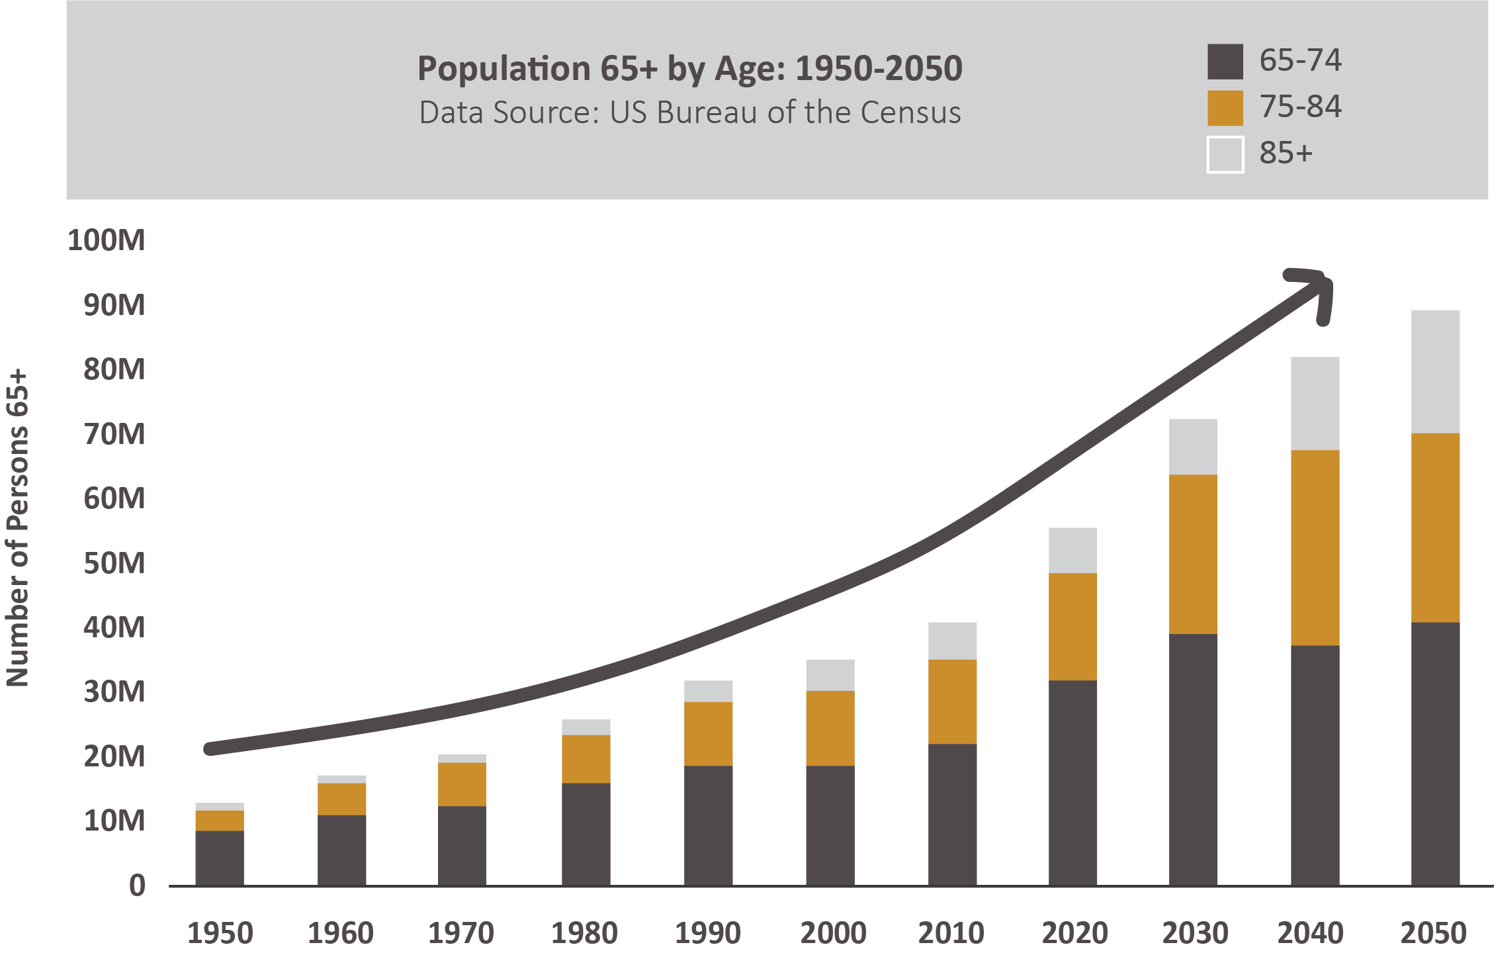
THE BABY BOOMERS ARE COMING…
The need for Senior Care is growing exponentially
US Census Date:
US Senior Care is a $400B industry
70% of individuals 65+ will require some type of long-term care services
Every day 10K baby boomers will turn 65 years old
By 2030 20% of US population will be 65+, compared to 12% in 2000
Information is proprietary and confidential

Slide 6
WHY EMPLOYERS SHOULD CARE
$13B
One in six US employees are spending 20+ hours each week providing assistance to a friend or relative.
Caregivers cost employers an estimated 8% more in healthcare costs than non-caregivers because their responsibilities are emotionally and physically exhausting.
Upper management has a higher incidence of leaving employment due to caregiving conflicts.
3
1
2
AARP report, Caregiving in the US
Supporting Caregivers in the Workplace: A practical guide for employers
Harvard Business School Study, Growing Caregiver Crisis hurting Firm Profitability
Information is proprietary and confidential

Slide 7
CURRENT LANDSCAPE
Less than 10% of people entering senior living and care solutions use a professional placement company
YOUR EMPLOYEES ARE AT A DISADVANTAGE
Seniors + their families
Limited knowledge
Limited experience
No leverage
Every person for themselves
Price taker
THEY ARE UP AGAINST
Senior housing
Corporate Owned (~120 Communities)
Have knowledge + experience
Have all the leverage
Price setter
Information is proprietary and confidential

Slide 8
CORPORATE BENEFIT PROGRAM
Guidance and real-dollar savings for employees struggling with caring for aging loved ones
SENIORS UNITED
Allow us to be the intermediary
Network of leading providers across the region
Expect to negotiate 5% discount off RENT only
Equates to ~$1,500-$3,000 ANNUAL savings per employee/family that uses the benefit
Seniors + their families
Senior housing
GUIDANCE
REAL-DOLLAR SAVINGS
Information is proprietary and confidential

Slide 9
PROGRAM SERVICES
30-minute phone consultation
With Elder Care Specialist available to all employees
Live Elder-Issues webinar
Virtual or in-person, twice per year
Referral service
To prequalified service providers
Placement service
For assisted living, independent living and memory care
Discounted consulting rates
At $100/hour (normally $150/hour)
*Coming in 2022: Discounts at leading providers
Information is proprietary and confidential

Slide 10
CORPORATE PRICING
PER MONTH | # EMPLOYEES
$200 | 200 - 499
$300 | 500 - 999
$600 | 1,000 – 4,999
$1,000 | 5,000 – 9,999
$3,000 | 10,000+
Information is proprietary and confidential

Slide 11
Mark S Molnar
mark.molnar@SeniorCareAuthority.com
440.781.9242
Senior Living and Care Solutions
Information is proprietary and confidential

